Slide 1
Simplified Instructional Computer (SIC)

Slide 2
SIC Architecture
Two versions: SIC and SIC/XE (extra equipments). SIC program can be executed on SIC/XE.
Memory consists of 8-bit bytes. 3 consecutive bytes form a word (24 bits)
In total, there are 2^15 bytes in the memory.
There are 5 registers. Each is 24 bits in length.

Slide 3
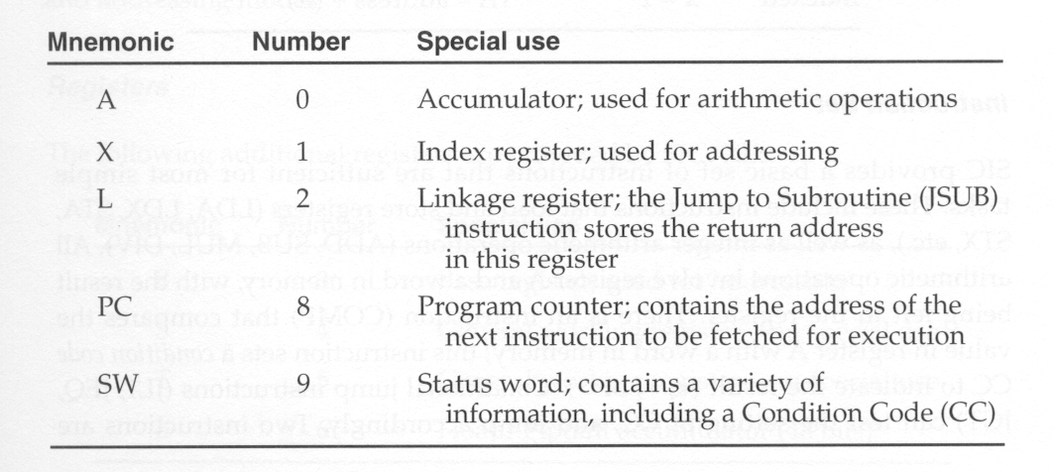
Five Registers

Slide 4
Data Format
Integers are stored as 24-bit binary numbers; 2’s complement representation is used for negative numbers.
Characters are store using their 8-bit ASCII codes.
There is no floating-point hardware on SIC.

Slide 5
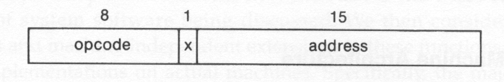
Instruction Format
All machine instructions on SIC has the following 24-bit format.
X is used to indicate indexed-addressing mode.

Slide 6
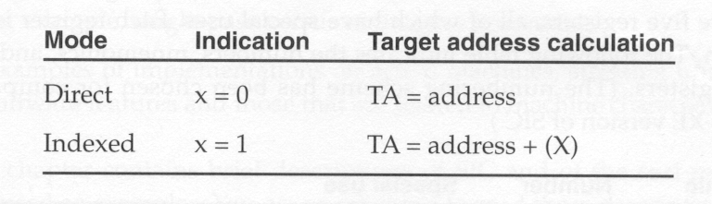
Addressing Modes
Only two modes are supported:
  Direct
  Indexed
() are used to indicate the content of a register.

Slide 7
Instruction Set
Load and store registers (LDA, LDX, STA, STX)
Integer arithmetic (ADD, SUB, MUL, DIV), all involve register A and a word in memory.
Comparison (COMP), involve register A and a word in memory.
Conditional jump (JLE, JEQ, JGT, etc.)
Subroutine linkage (JSUB, RSUB)

Slide 8
Input and Output
One byte at a time to or from the rightmost 8 bits of register A.
Each device has a unique 8-bit ID code.
Test device (TD): test if a device is ready to send or receive a byte of data.
Read data (RD): read a byte from the device to register A
Write data (WD): write a byte from register A to the device.

Slide 9
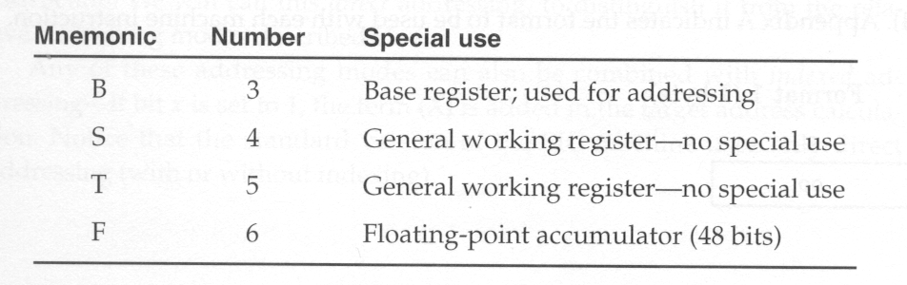
SIC/XE Architecture
Memory: 1 megabytes (2^20 bytes)
Additional Registers

Slide 10
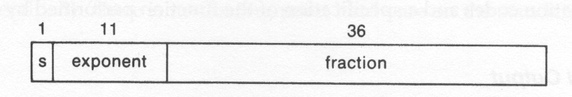
Data Format
The same as that of SIC.
There is a floating-point data type with the following format:
Between 0 and 1
Must be 1
The value represented by the above format is (-1)^s * f * 2 ^(e – 1024)

Slide 11
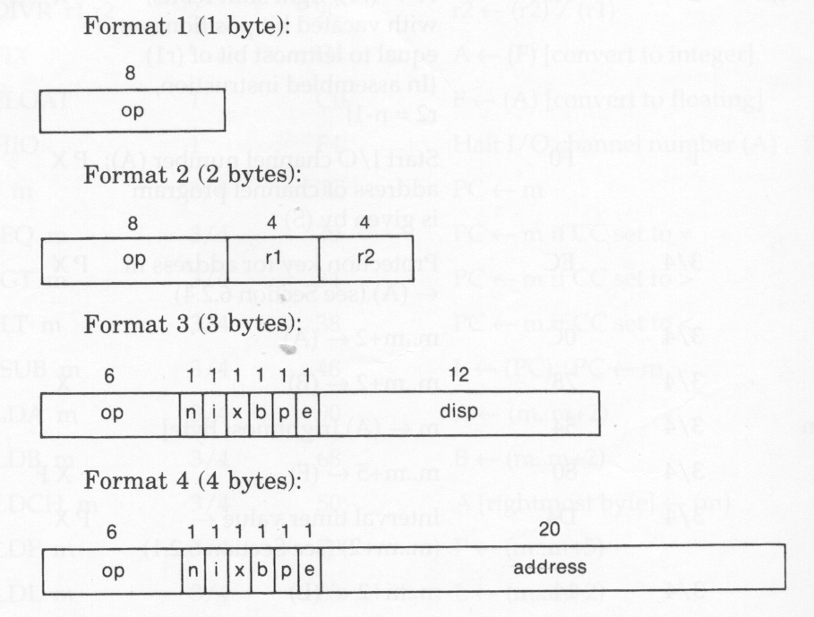
Instruction Formats
e = 0
e = 1

Slide 12
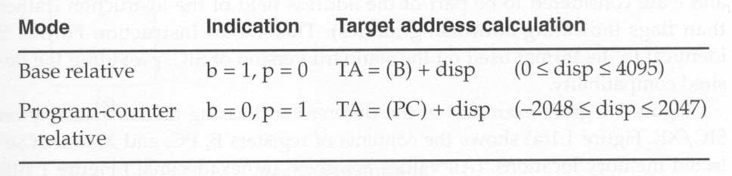
Addressing Mode
Two additional modes are introduced for format 3:
In format 3, if both bits b and p are set to 0, the disp
(or address) is taken as the target address. This is called direct
addressing mode.
Both modes can be combined with indexed addressing – if bit
x is set to 1, the value of register X is added in the target
Address calculation.

Slide 13
Addressing Modes
For format 3 and 4:
(i =1, n = 0): immediate addressing mode. The target address is used as the operand.
(i = 0, n = 1): indirect addressing mode. The word at the location given by the target address is fetched; the value contained in this word is then used as the address of the operand value.
(i = 0, n = 0) used by SIC, (i=1, n=1) used by SIC/XE: simple addressing mode. The target address is taken as the location of the operand.
Indexing mode cannot be used with immediate or indirect modes.

Slide 14
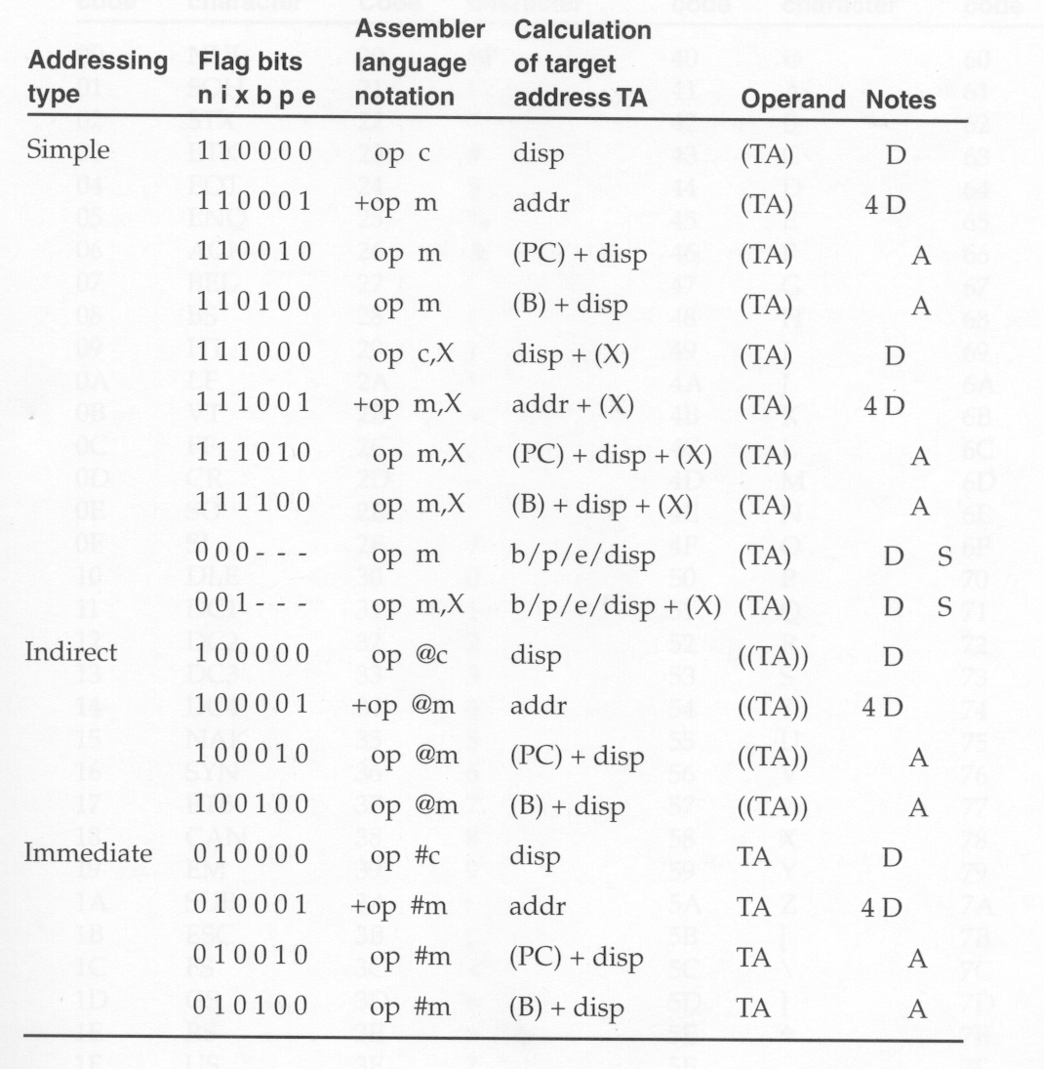

Slide 15
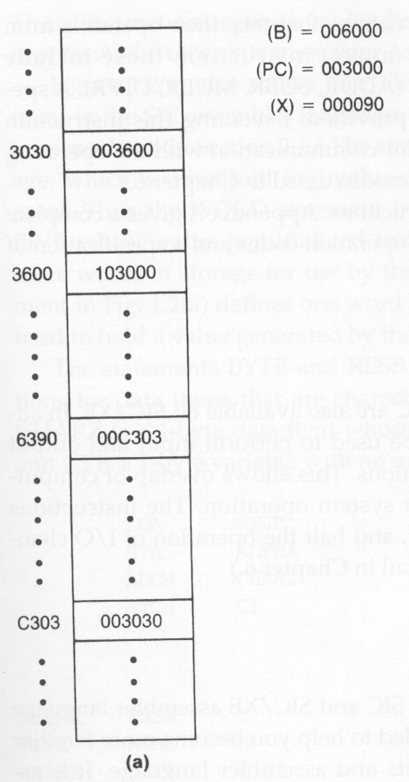
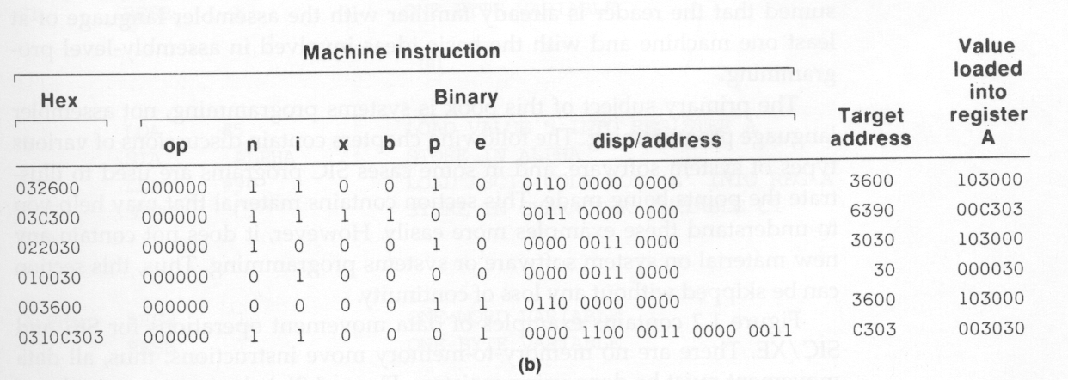
Example
All of these instructions are LDA.

Slide 16
Instruction Set
LDB and STB
Floating-point operations (ADDF, SUBF, MULF, DIVF)
Register move (RMO)
Register-to-register operations (ADDR, SUBR, MULR, DIVR)
Supervisor call (SVC) for generating system calls into the operating system.
I/O channel operation (SIO: start, TIO: test, HIO: halt), similar to DMA.

